Slide 1
Continuous Delivery
Notes:
Updated: March 2020
Information in this document, including URL and other Internet Web site references, is subject to change without notice. Unless otherwise noted, the example companies, organizations, products, domain names, e-mail addresses, logos, people, places, and events depicted herein are fictitious, and no association with any real company, organization, product, domain name, e-mail address, logo, person, place or event is intended or should be inferred. Complying with all applicable copyright laws is the responsibility of the user. Without limiting the rights under copyright, no part of this document may be reproduced, stored in or introduced into a retrieval system, or transmitted in any form or by any means (electronic, mechanical, photocopying, recording, or otherwise), or for any purpose, without the express written permission of Microsoft Corporation.
Microsoft may have patents, patent applications, trademarks, copyrights, or other intellectual property rights covering subject matter in this document. Except as expressly provided in any written license agreement from Microsoft, the furnishing of this document does not give you any license to these patents, trademarks, copyrights, or other intellectual property.
The names of manufacturers, products, or URLs are provided for informational purposes only and Microsoft makes no representations and warranties, either expressed, implied, or statutory, regarding these manufacturers or the use of the products with any Microsoft technologies. The inclusion of a manufacturer or product does not imply endorsement of Microsoft of the manufacturer or product. Links may be provided to third party sites. Such sites are not under the control of Microsoft and Microsoft is not responsible for the contents of any linked site or any link contained in a linked site, or any changes or updates to such sites. Microsoft is not responsible for webcasting or any other form of transmission received from any linked site. Microsoft is providing these links to you only as a convenience, and the inclusion of any link does not imply endorsement of Microsoft of the site or the products contained therein.
© 2020 Microsoft Corporation. All rights reserved. Microsoft and the trademarks listed at https://www.microsoft.com/en-us/legal/intellectualproperty/Trademarks/Usage/General.aspx are trademarks of the Microsoft group of companies. All other trademarks are property of their respective owners.

Slide 2
Abstract and learning objectives
In this whiteboard design session, you will learn how to design a solution with GitHub and Azure DevOps to enable continuous delivery with several Azure PaaS services.
At the end of this workshop, you will be better able to automate cloud infrastructure and reduce error-prone manual processes. In addition, you'll learn how to design a deployment automation, Application Insights for deep application monitoring, and GitHub as a source code repository, and GitHub and Azure DevOps build/deploy pipelines.

Slide 3
Step 1: Review the customer case study
Outcome
Analyze your customer needs.
Timeframe
15 minutes

Slide 4
Customer situation
Fabirkam Medical Conferences provide conference website services tailored to the medical community. Over the course of ten years, they have built conference sites for a small conference organizer. Through word of mouth, Fabrikam Medical Conferences has become a well-known industry brand handling over 100 conferences per year and growing.
In the current situation, the conference sites are hosted on-premises using a MEAN stack with web sites and APIs hosted on Linux machines with MongoDB running on a separate cluster of Linux machines.

Slide 5
Customer situation
The VP of Engineering at Fabrikam, Susan Withers, has a team of 12 developers who handle all aspects of development, testing, deployment, and operational management of their customer sites. Due to customer demands, they have issues with the efficiency and reliability the conference websites. This mainly caused by an inefficient development and operations workflow.

Slide 6
Customer needs
Reduce the overhead in time, complexity, and cost for deploying new conference tenants.
Improve the reliability of conference tenant updates.
Choose a suitable platform for their conference solution.
Migrate data from MongoDB on-premises to CosmosDB with the least change possible to the application code.

Slide 7
Customer needs
Make use of GitHub and/or Azure DevOps for development lifecycle.
Use Git repositories for source control and integration into a CI/CD workflow.
Embed code review and security scanning in to the development workflow.
Do not incur a direct vendor lock-in.

Slide 8
Fabrikam Medical Conferences
Current Process

Slide 9
Customer objections
We do not want to be locked into a specific source control repository. We are evaluating GitHub and Azure DevOps and need to be able to change between them without frustrating rework.
We do not want the developers to be able to make changes to the Azure resources even though they will have access to make source code changes.
If developers can deploy directly to the cloud, will that expose us to the same quality problems we had before when untested code was promoted to production?

Slide 10
Customer objections
How much of an impact will these process changes have on our development cadence? Will learning this place a new burden on the developers?
Our developers are already having challenges learning how to use Git; will adding a continuous deployment system on top of that slow them down and confuse them even more?

Slide 11
Common scenarios

Slide 12
Step 2: Design a proof of concept solution
Outcome
Prepare to present a solution for your target audience.
Timeframe
60 minutes

Slide 13
Step 2: Design the solution
Outcome
Design a solution and prepare to present the solution to the target customer audience in a 15-minute chalk-talk format.
Timeframe
60 minutes
Business needs (10 minutes) | Respond to questions outlined in your guide and list the answers on a flipchart.
Design (35 minutes) | Design a solution for as many of the stated requirements as time allows. Show the solution on a flipchart.
Prepare (15 minutes) | Identify any customer needs that are not addressed with the proposed solution. Identify the benefits of your solution. Determine how you will respond to the customer’s objections. Prepare for a 15-minute presentation to the customer.

Slide 14
Step 3: Present the solution
Outcome
Present a solution to the target customer in a 15-minute chalk-talk format.
Timeframe
30 minutes (15 minutes for each team to present and receive feedback)
Directions
Pair with another table.
One table is the Microsoft team and the other table is the customer.
The Microsoft team presents their proposed solution to the customer.
The customer asks one of the objections from the list of objections in the case study.
The Microsoft team responds to the objection.
The customer team gives feedback to the Microsoft team.

Slide 15
Wrap-up
Outcome
Review preferred solution.
Timeframe
15 minutes

Slide 16

Preferred target audience
Susan Withers, VP of Engineering
Development team

Slide 17
Preferred solution

Slide 18
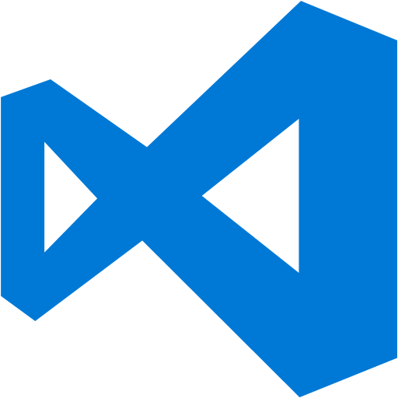
Automate software builds and deployments
Azure DevOps build and release management are a complete end to end solution for automating builds deployment for the solutions
Create a build definition.
Create a release pipeline that deploys the solution to one or more environments with validation and verification.
Setup approval steps as quality gates to control the flow of each release.
Notes:
Continuous Integration and Deployment
What available system should you use to automate software builds and deployments of the application?
Azure DevOps' build and release management features are a complete end to end solution for automating builds deployment for the solutions. From there, you can customize the gates your solution needs to promote the solution from environment to environment. You're in complete control of how the CI/CD process is implemented.
Once we have the build definition producing build artifacts, we create a release pipeline using the Release Management features of Azure DevOps.
The release pipeline is like the build definition in that it is a series to steps or tasks that we put together to produce an outcome. In this case...we produce the deployment of a release to one or more environments and perform some level of validation and verification of each release.
We can then configure approval steps between each environment as quality stage gates. This allows us to control the flow of releases as they proceed through the environments.
The pipeline for development would simply deploy upon a successful build from the build pipeline.
Then, before we deploy to test, we may want the QA team to decide when to deploy the release into the environment. If that were the case, we would configure a manual approval and the deployment, although still automated, would not occur until a member of the QA team approved it to be deployed. This is useful when a QA team may be reviewing an existing release (previously deployed) and does not want the current release to be overwritten in their test environment.
Once the deployment to test occurs, we would likely have additional acceptance tests executed.
If these acceptance tests pass, we could then trigger the deployment to production.
It is important to note that each environment can have its own set of tasks as often times, the deployment and validation steps vary by environment.
Explain how you can continuously deploy new builds directly to the cloud without interfering with the production site.
For a production deployment, the customer wants to maintain the uptime of the application. Thus, when we are deploying a new release, we want the application to remain available.
Azure App Services have a deployment slot feature specifically to enable this scenario. Each App Service has, by default, a production deployment slot. This is not to be confused with a production environment. For the purposes of this case study, we could add a new deployment slot named "staging."
To do this, we add an additional deployment slot to the Azure App Service and configure the release pipeline to deploy to the newly created deployment slot.
Assuming a successful deployment and verification to the staging slot, we add an additional task to the deployment that switches the staging deployment slot with the production deployment slot and all new requests will be directed to the newly deployed application. All of this is done with no downtime to the application.
Document how to integrate unit tests into the continuous delivery process such that when a test fails to pass, the deployment process is flagged and stopped.
Let's assume your solution already includes a test project with unit tests. You can create or edit your build definition to include a task (Visual Studio Test task) that runs unit tests. After your build starts, this task automatically runs all the unit tests in your solution. If one or more tests fail, the continuous delivery process will halt for that particular build. You could then also configure the test task to create a new work item when a test fails.
Explain how you can test a new build simultaneously with an existing build, like an A/B test?
The most common technique to meet this requirement is to create a deployment slots where your App Service variation can be deployed to. Then, configure the release pipeline to deploy to the preferred deployment slot. Using the Azure Portal you can configure the Traffic Routing feature, specifying which percentage of users should go to the primary site and each deployment slot when they browse to your site's URL. Additionally, you could use Application Insights to measure the effectiveness of each version of the site.
Why shouldn't we have multiple long lived branches in source control?
If you think if your work as delta off of a master...the size of the delta increases as your branch incorporates more and more work. As the size of your team grows, the amount of work hidden from each other increases. And the chances that your assumptions about the state of the code hold true decreases the more you use long lived branches. If you merge your code back to master frequently, you demonstrate the direction you're taking the code. When you merge your code more frequently to master, the pain of integration happens at the beginning instead of the end of your work. This allows you to find issues faster and fix them at the earliest possible moment. Merging your code frequently also results in fewer merge conflicts. If you're developing a large feature, consider using feature flags so that you can continue to merge your code frequently.
Create a plan on how to switch the source control location from Azure DevOps to GitHub.
Let's assume you have already uploaded your codebase to GitHub from Azure DevOps. First, start by editing your existing build definition. When you initially configured the build definition, you selected Azure DevOps as the source for your code. You would now change the "Get sources" item to select GitHub. This, in turn, will require you to authenticate to GitHub (if you have not previously done so). Finally, you select the specifics for your Repository and Default branch. The rest of the build and release process remains unchanged.

Slide 19
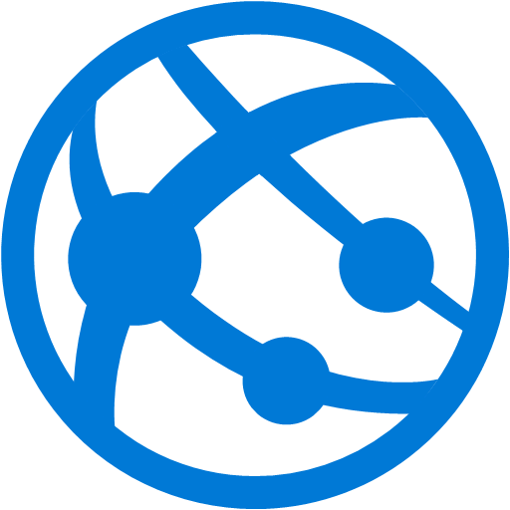
Continuous deployment without production impact
Use the deployment slots feature of Azure App Services.
Create and deploy to a staging slot.
Release and validate .
Swap staging with production.
Notes:
Explain how you can continuously deploy new builds directly to the cloud without interfering with the production site.
For a production deployment, the customer wants to maintain the uptime of the application. Thus, when we are deploying a new release, we want the application to remain available.
Azure App Services have a deployment slot feature specifically to enable this scenario. Each App Service has, by default, a production deployment slot. This is not to be confused with a production environment. For the purposes of this case study, we could add a new deployment slot named “staging.”
To do this, we add an additional deployment slot to the Azure App Service and configure the release pipeline to deploy to the newly created deployment slot.
Assuming a successful deployment and verification to the staging slot, we add an additional task to the deployment that switches the staging deployment slot with the production deployment slot and all new requests will be directed to the newly deployed application. All of this is done with no downtime to the application.

Slide 20
Unit test integration
Create the build definition and add a task to run the unit tests.
If one or more test fails, the continuous delivery process will halt.
Extend the task to create a new work item for tracking if the test fails.
Notes:
Document how to integrate unit tests into the continuous delivery process such that when a test fails to pass, the deployment process is flagged and stopped.
Let’s assume your solution already includes a test project with unit tests. You can create or edit your build definition to include a task (Visual Studio Test task) that runs unit tests. After your build starts, this task automatically runs all the unit tests in your solution. If one or more tests fail, the continuous delivery process will halt for that particular build. You could then also configure the test task to create a new work item when a test fails.

Slide 21
How to enable A/B testing
Use Azure App Services deployment slots in conjunction with the Traffic Routing feature.
Direct some percentage of traffic to a separate slot, use Application Insights to measure effectiveness.
Notes:
Explain how you can test a new build simultaneously with an existing build, like an A/B test?
The most common technique to meet this requirement is to create a deployment slots where your App Service variation can be deployed to. Then, configure the release pipeline to deploy to the preferred deployment slot. Using the Azure Portal you can configure the Traffic Routing feature, specifying which percentage of users should go to the primary site and each deployment slot when they browse to your site’s URL. Additionally, you could use Application Insights to measure the effectiveness of each version of the site.

Slide 22
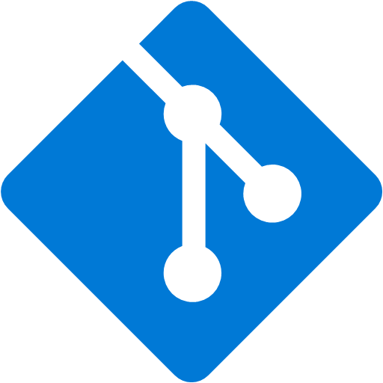
Source Control
Avoid branches with long life spans.
Switching source control from Azure DevOps to GitHub by uploading the code base and editing the build definition.
Notes:
Why shouldn’t we have multiple long lived branches in source control?
If you think if your work as delta off of a master…the size of the delta increases as your branch incorporates more and more work. As the size of your team grows, the amount of work hidden from each other increases. And the chances that your assumptions about the state of the code hold true decreases the more you use long lived branches. If you merge your code back to master frequently, you demonstrate the direction you’re taking the code. When you merge your code more frequently to master, the pain of integration happens at the beginning instead of the end of your work. This allows you to find issues faster and fix them at the earliest possible moment. Merging your code frequently also results in fewer merge conflicts. If you’re developing a large feature, consider using feature flags so that you can continue to merge your code frequently.
Create a plan on how to switch the source control location from Azure DevOps to GitHub.
Let’s assume you have already uploaded your codebase to GitHub from Azure DevOps. First, start by editing your existing build definition. When you initially configured the build definition, you selected Azure DevOps as the source for your code. You would now change the “Get sources” item to select GitHub. This, in turn, will require you to authenticate to GitHub (if you have not previously done so). Finally, you select the specifics for your Repository and Default branch. The rest of the build and release process remains unchanged.

Slide 23
Customer objections
We do not want to be locked in to a specific source control repository. We are evaluating GitHub and Azure DevOps and need to be able to change between them without frustrating rework.
Both Azure DevOps and GitHub support git source control repositories. Azure DevOps supports any accessible git repository and has specific additional integrations with GitHub. As long as the customer project uses git-based source control, Azure DevOps can be used to build and deploy the project.

Slide 24
Customer objections
We do not want the developers to be able to make changes to the Azure resources even though they will have access to make source code changes.
This solution would remove the need to provide access to these specific environments from the developers. The company could provide other access (i.e. Enterprise DevTest Subscriptions) that developers could use to explore the features of the platform.

Slide 25
Customer objections
If developers can deploy directly to the cloud, will that expose us to the same quality problems we had before when untested code was promoted to production?
If we use Azure DevOps’ Release Management features, we can configure all the necessary rules / approvals for ensuring a smooth and secure deployment process. The goal here is to remove human touches from the process thus increasing the stability of the release process.

Slide 26
Customer objections
How much of an impact will these process changes have on our development cadence? Will learning this place a new burden on the developers?
CI/CD is a commitment. To achieve velocity with confidence, there is a required rigor in testing that becomes key to success. This will likely result in a learning curve where you must slow down to go fast. It might even be painful at the start, but that pain is ultimately what drives the automation, monitoring, and incident handling efforts.

Slide 27
Customer objections
Our developers are already having a challenge learning how to use Git, will adding a continuous deployment system on top of that slow them down and confuse them even more?
There is a learning curve with every quality gate added. Developers will need to do more automated testing locally to ensure code will pass the CI process. Working from master (or trunk) requires that developers really own the state of the build process. When the build is broken, fixing the build becomes the priority. This is another area where we slow down to go faster, with higher quality deliverable.

